Slide 1
Introduction to algorithm & programming concepts
Krishna Chakravarty

Slide 2
contents
Algorithm
Step form
Pseudo code
Flow Chart
Why C
Basic C structure
Compilation stages
Programming concepts

Slide 3
What is algorithm
Program = Algorithm + Data
Effective procedure for solving a problem in a finite number of steps.
It also terminates (ends).
Effective = answer is found
Different ways of stating algorithm
Step form : statements to follow in steps
Pseudo Code : English form with restricted vocabs
Flowchart
Nassi-Schneiderman
The last two are graphically oriented representation with sequence, decision, repetition actions

Slide 4
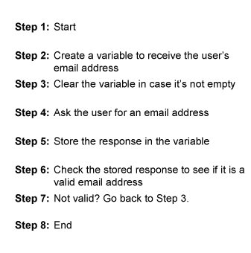
Simple Algorithm : in steps

Slide 5
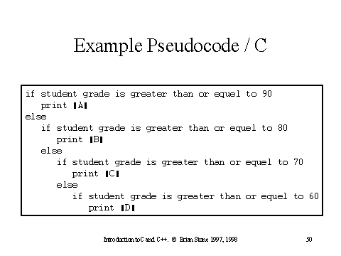
Simple Algorithm : pseudo-code

Slide 6
Simple Algorithm : flow chart
start
Process 1
Process Y
Process X
False
Decision
True

Slide 7
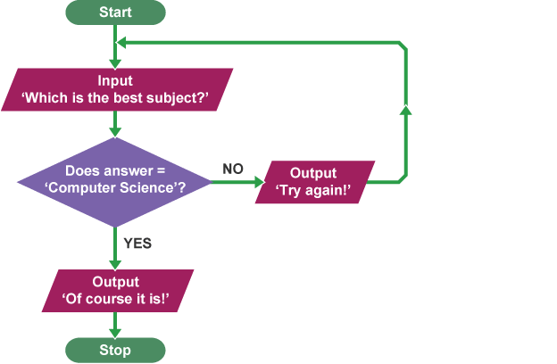
Simple Algorithm : flow chart
Is Ans=
Computer ?

Slide 8
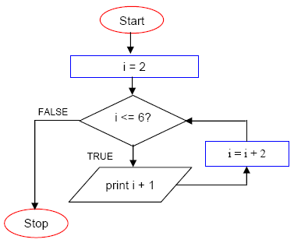
Simple Algorithm : flow chart
Output
3
5
7

Slide 9
WHY c?
C is a core language - C is considered the grandfather of most modern programming languages, and if you have a strong foundation in C, you can apply the concepts in C to those higher level languages.
Block structured, procedural, imperative, cross platform
C forces you to build a mental model of what the computer is actually doing when you run your programs
Quite simple to get started.
C is a small language : It has less data type, only 32 keywords (20 common use, like case , break, double, int etc)
C is quick : program runs quickly, very close to the hardware. Can avail low level facilities without affecting run time.
C is portable : program written on one system can run with little or no modification on other system. If modifications needed, a few changes in header file is required.

Slide 10
Designing of algorithm
Investigate the steps – identify input, output, decision and conditions, processes.
Top down approach
Refine each step, error handling

Slide 11
Structured programming
Organized programs
Correct and clear data description, control structure.
Readable, understandable, modifiable.

Slide 12
Developing program in c
Writing the program :
use text editor or an IDE (Integrated Development Environment)
Save file with .c extension
Compiling the program – details in next page
Executing program –
Each statement is sequentially executed.
If program requests data from user, waits for input.
Or program can wait for an event like mouse click.
Results or output displays on the screen
Results can also be stored in a file.

Slide 13
Compiling a c program – four steps
Step-1
Preprocessing
It processes include files, conditional compiler instructions and macros
Preprocessor directives are there in the source code which specifies instructions on how to modify the source code
Step-2
Compilation
Generates the assembly source code
Checks syntaxes and semantics, generates error. Program has to be recompiled.

Slide 14
Compiling a c program – four steps
Step-3
Assembly
Takes assembly code and generates object code (binary format)
Object code is written into another file on the system
filename.c filename.o
Step-4
Linking
Purpose of linking phase is to get the program in final form for execution.
The functions are part of standard C library, provided in C compiler

Slide 15
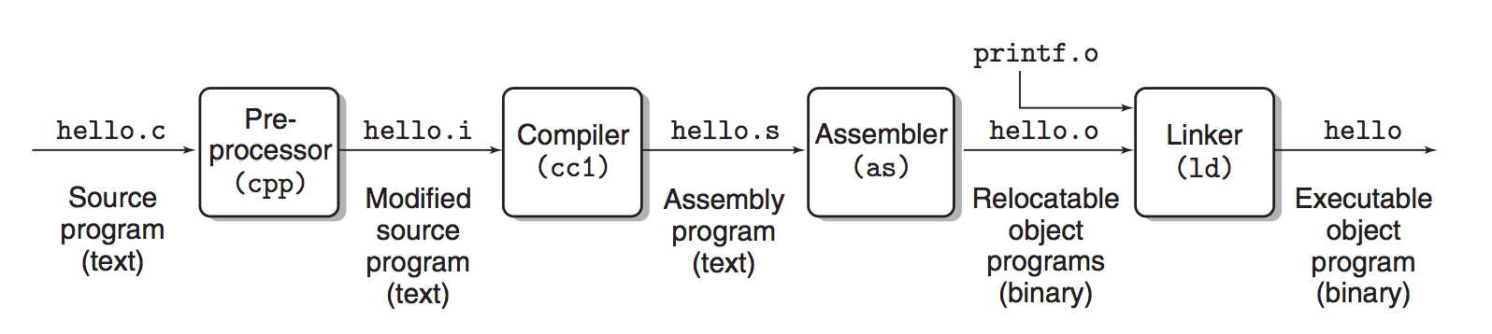
Compiling a c program – example

Slide 16
error
Compilation error
Given by compiler and prevent program from running
Linking error
Given by linker or at run time
If part of program is missing or non existent library component
Run time error
Given by operating system

Slide 17
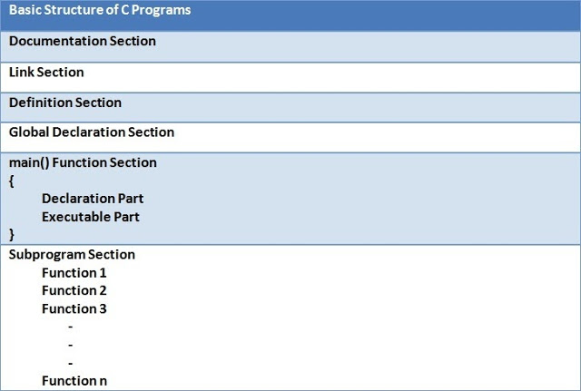
Basic structure of c
Chapter 8

Slide 18
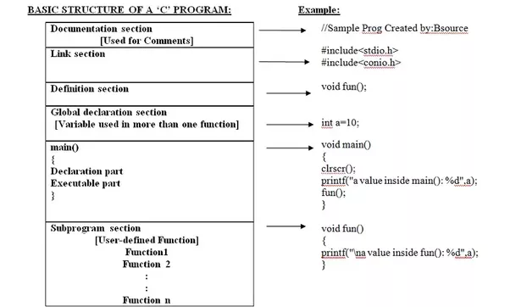
Basic structure of c

Slide 19
Declaration and definition
Preprocessor directive (link section) : tells preprocessor to look for these special code libraries which will be needed.
Definition (global) section : declaration of a data object nd also allocate space to hold the data object
Global declaration – it is visible to all parts of program.
Main()
Local definition – data objects which will be used inside main.
Statements - instructions to be performed
 | Declaration | Definition
1 | Describing the type of a data object to the compiler | Declaration of the data object
2 | Does not allocate any space | Allocates space to hold the data object

Slide 20
Parts of program
Header files (Link section) :
The standard header files that provide input output functions. (stdio.h)
The standard library has 24 standard libraries
Philosophy of main ()
User defines function, it is the first function in the program which gets called (program start up).
int main(void) {/*..*/} no parameter
int main(int argc)
Three return value of main
Plain integer value 0
Constant EXIT_SUCCESS defined in stdlib.h
Constant EXIT_FAILURE defined in stdlib.h
It is the must for any standard C program.

